Slide 1
Software Engineering BCA IV SEM
Software Requirement Analysis and Specification
Bijay Babu Regmi
bijay.regmi@deerwalk.edu.np

Slide 2
System and Software Requirements
Requirements are descriptions of the services that a software system must provide and the constraints under which it must operate.
Requirements can range from high-level abstract statements of services or system constraints to detailed mathematical functional specifications.
Requirements Engineering is the process of establishing the services that the customer requires from the system and the constraints under which it is to be developed and operated .
Requirements may serve a dual function:
- As the basis of a bid for a contract
- As the basis for the contract itself

Slide 3
Software Requirements
Requirement is a condition or capability possessed by the software or system component in order to solve a real world problem. The problems can be to automate a part of a system, to correct shortcomings of an existing system, to control a device, and so on.
IEEE defines requirement as (1) A condition or capability needed by a user to solve a problem or achieve an objective. (2) A condition or capability that must be met or possessed by a system or system component to satisfy a contract, standard, specification, or other formally imposed documents. (3) A documented representation of a condition or capability as in (1) or (2).’
Requirements describe how a system should act, appear or perform. For this, when users request for software, they provide an approximation of what the new system should be capable of doing.
Requirements differ from one user to another and from one business process to another.

Slide 4
Continued….
Software Requirement Specification (SRS):
a document created by system analyst after the requirements are collected from various stakeholders
defines how the intended software will interact with hardware, external interfaces, speed of operation, response time of system, portability of software across various platforms, maintainability, speed of recovery after crashing, Security, Quality, Limitations etc.
The requirements received from client are written in natural language. It is the responsibility of the system analyst to document the requirements in technical language so that they can be comprehended and used by the software development team.

Slide 5
Continued….
SRS should come up with the following features:
User Requirements are expressed in natural language.
Technical requirements are expressed in structured language, which is used inside the organization.
Design description should be written in Pseudo code.
Format of Forms and GUI screen prints.
Conditional and mathematical notations for DFDs etc.

Slide 6
Software Requirement Validation
After requirement specifications are developed, the requirements mentioned in this document are validated. User might ask for illegal, impractical solution or experts may interpret the requirements inaccurately. This results in huge increase in cost if not nipped in the bud. Requirements can be checked against following conditions –
If they can be practically implemented
If they are valid and as per functionality and domain of software
If there are any ambiguities
If they are complete
If they can be demonstrated

Slide 7
Continued….
During the requirements validation process, different types of checks should be carried out on the requirements. These checks include:
Validity checks:
- The functions proposed by stakeholders should be aligned with what the system needs to perform. You may find later that there are additional or different functions are required instead.
Consistency checks:
- Requirements in the document shouldn’t conflict or different description of the same function
Completeness checks:
- The document should include all the requirements and constrains.
Realism checks:
- Ensure the requirements can actually be implemented using the knowledge of existing technology, the budget, schedule, etc.
Verifiability:
- Requirements should be written so that they can be tested. This means you should be able to write a set of tests that demonstrate that the system meets the specified requirements.

Slide 8
Continued….
There are several techniques which are used either individually or in conjunction with other techniques to check to check entire or part of the system:
Test case generation:
- The requirements specified in the SRS document should be testable. The test in the validation process can reveal problems in the requirement. In some cases test becomes difficult to design, which implies that the requirement is difficult to implement and requires improvement.
Prototyping:
- In this validation techniques the prototype of the system is presented before the end-user or customer, they experiment with the presented model and check if it meets their need. This type of model is generally used to collect feedback about the requirement of the user.
Requirements Reviews:
- In this approach, the SRS is carefully reviewed by a group of people including people from both the contractor organizations and the client side, the reviewer systematically analyses the document to check error and ambiguity.

Slide 9
Continued….
Automated Consistency Analysis:
- This approach is used for automatic detection of an error, such as non- determinism, missing cases, a type error, and circular definitions, in requirements specifications. First, the requirement is structured in formal notation then CASE tool is used to check in-consistency of the system, The report of all inconsistencies is identified and corrective actions are taken.
Walk-through:
- A walkthrough does not have a formally defined procedure and does not require a differentiated role assignment.
- Checking early whether the idea is feasible or not.
- Obtaining the opinions and suggestion of other people.
- Checking the approval of others and reaching an agreement.

Slide 10
Types of Requirements
Functional Requirements
Non-Functional Requirements
Domain Requirements
Functional Requirements:
- IEEE defines functional requirements as ‘a function that a system or component must be able to perform.’
- describe the interaction of software with its environment and specify the inputs, outputs, external interfaces, and the functions that should be included in the software
- services provided by functional requirements specify the procedure by which the software should react to particular inputs or behave in particular situations
- All these functionalities need to be necessarily incorporated into the system as a part of the contract

Slide 11
Non-Functional Requirements
arise due to user requirements, budget constraints, organizational policies, and so on
are not related directly to any particular function provided by the system
can be the necessities that specify the criteria that can be used to decide the operation instead of specific behaviors of the system
are also called non-behavioral requirements
basically deal with issues like:
Portability
Security
Maintainability
Reliability
Scalability
Performance
Reusability
Flexibility

Slide 12
Domain Requirements
are the requirements which are characteristic of a particular category or domain of projects
The basic functions that a system of a specific domain must necessarily exhibit come under this category
For instance, in an academic software that maintains records of a school or college, the functionality of being able to access the list of faculty and list of students of each grade is a domain requirement.
These requirements are therefore identified from that domain model and are not user specific.

Slide 13
User Requirements
statements in natural language plus diagrams of the services that the systems provides and its operational constraints
written for customer
typically written when discussing the use cases for a project
is done with the customer or product managers that know how the embedded system will be used by the user
deal with how a user will interact with a system and what that user expects
For example: If there is a screen or human machine interface aspect to the system, a user requirement may be based on what happens when the user selects an action on the screen. Maybe with a button press not only does a process start, but it also switches to another screen and provides an audible notification.

Slide 14
Requirement Analysis and Elicitation
is the process of interacting with customers and end-users to find out about the domain requirements, what services the system should provide, and the other constrains
also involve a different kinds of stockholders; end-users, managers, system engineers, test engineers, maintenance engineers, etc
has four main processes:
- Requirements Discovery
- Requirements classification and organization
- Requirements prioritization and negotiation
- Requirements specification

Slide 15
Requirements Discovery
It’s the process of interacting with, and gathering the requirements from, the stakeholders about the required system and the existing system (if exist).
It can be done using some techniques, like interviews, scenarios, prototypes, etc, which help the stockholders to understand what the system will be like.
That’s because stakeholders may not know what exactly they want the software to do, or they may give un-realistic requirements.
They may give different requirements, which will result in conflict between the requirements, so we have to discover and resolve these conflicts.

Slide 16
Requirements Classification and Organization
It’s very important to organize the overall structure of the system.
Putting related requirements together, and decomposing the system into sub components of related requirements. Then, we define the relationship between these components.
What we do here will help us in the decision of identifying the most suitable architectural design patterns.

Slide 17
Requirements Prioritization and Negotiation
This activity is concerned with prioritizing requirements and finding and resolving requirements conflicts through negotiations until you reach a situation where some of the stakeholders can compromise.
Prioritizing your requirements will help you later to focus on the essentials and core features of the system, so you can meet the user expectations. It can be achieved by giving every piece of function a priority level. So, functions with higher priorities need higher attention and focus.

Slide 18
Requirements Specification
It’s the process of writing down the user and system requirements into a document. The requirements should be clear, easy to understand, complete and consistent.
In practice, this is difficult to achieve as stakeholders interpret the requirements in different ways and there are often inherent conflicts and inconsistencies in the requirements.
a specification for a specific software product, program, or set of applications that perform particular functions in a specific environment

Slide 19
Features of SRS
Correctness: User review is used to provide the accuracy of requirements stated in the SRS. SRS is said to be perfect if it covers all the needs that are truly expected from the system.
Completeness: The SRS is complete if, and only if, it includes the following elements:
- All essential requirements, whether relating to functionality, performance, design, constraints, attributes, or external interfaces.
- Definition of their responses of the software to all realizable classes of input data in all available categories of situations.
- Full labels and references to all figures, tables, and diagrams in the SRS and definitions of all terms and units of measure.
Modifiability: SRS should be made as modifiable as likely and should be capable of quickly obtain changes to the system to some extent. Modifications should be perfectly indexed and cross-referenced.
Verifiability: SRS is correct when the specified requirements can be verified with a cost-effective system to check whether the final software meets those requirements. The requirements are verified with the help of reviews.

Slide 20
Continued….
Design Independence: There should be an option to select from multiple design alternatives for the final system. More specifically, the SRS should not contain any implementation details.
Testability: An SRS should be written in such a method that it is simple to generate test cases and test plans from the report.
Understandable by the customer: An end user may be an expert in his/her explicit domain but might not be trained in computer science. Hence, the purpose of formal notations and symbols should be avoided too as much extent as possible. The language should be kept simple and clear.

Slide 21
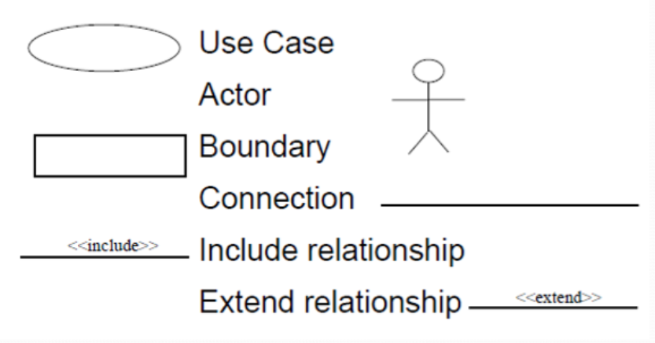
Use Cases and Scenarios
two different techniques, but, usually they are used together
Use cases identify interactions between the system and it’s users or even other external systems (using graphical notations), while a scenario is a textual description of one or more of these interactions.
Use case involves some symbols to describe the system:
Fig: Use Case Symbol

Slide 22
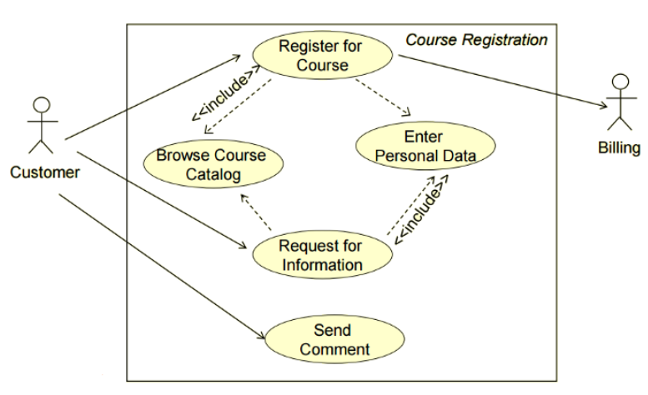
Continued….
For example:

Slide 23
Continued….
Actors: Are those who interact with the system; human or other systems
Interaction (Use Case): It denotes the name of the interaction (verb). It’s represented as a named ellipse.
Connection: Lines that links between the actors and the interactions.
Include Relationship: It denotes a connection between two interactions when an interaction is invoked by another. As an example, splitting a large interaction into several interactions.
Exclude Relationship: It denotes a connection between two interactions when you want to extend an interaction by adding an optional behavior, but you can use the main interaction on it’s own without the extending interaction.

Slide 24
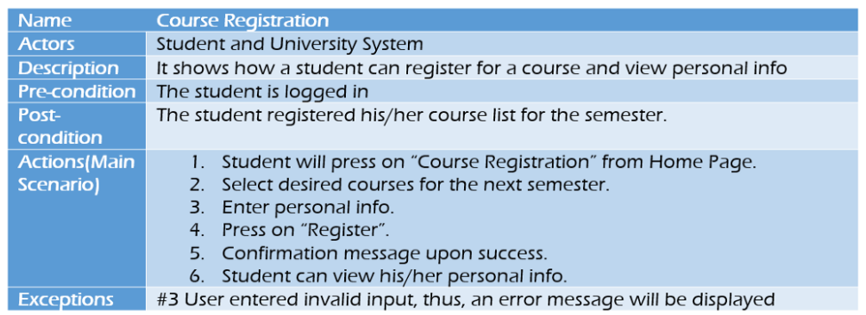
Continued….
Now, we are going to use scenarios to describe the interactions in each use case textually. They should have a format and include the following:
A description of the initial situation.
A description of the flow of the events or interactions with the system
A description of the exceptions, or in other words, what can go wrong, and how it can be handled.
Any concurrent activities should be mentioned
A description of the final state.
Here is the example for a scenario for the use case example above.

Slide 25
Interviews
In Interviews, requirements engineering teams put the questions to the stakeholder about the system that’s currently used, and the system to be developed, and hence they can gather the requirements from the answers.
The questions fall under two categories:
- Closed-Ended questions: A pre-defined set of question.
- Open-Ended questions: There is no a pre-defined expected answer, they are more of generic questions. It’s used to explore issues that’s not clear in a less structured way.
Interviews are good to get an overall understanding of what stakeholders need, how they might interact with the new system, and the difficulties they face with the current system.
However, interviews aren’t so helpful in understanding the domain requirements. This is for two reasons:
Domain requirements may be expressed using special domain terminologies, and software engineers often find it difficult to understand and it’s easy for them to misunderstand.
Sometimes stakeholders won’t tell you some requirements because they assume it’s so fundamental and it doesn’t worth mentioning, or they find it difficult to explain, which won’t be taken into consideration in the requirements.

Slide 26
View Points
A viewpoint-based approach to requirements engineering recognizes that all information about the system requirements cannot be discovered by considering the system from a single perspective. Rather, we need to collect and organize requirements from a number of different viewpoints.
A key strength of viewpoint-oriented analysis is that it recognizes the existence of multiple perspectives and provides a framework for discovering conflicts in the requirements proposed by different stakeholders. Viewpoints can be used as a way of classifying different types of stakeholder and other sources of requirements.
In the viewpoint-based methods which have been developed, three different kinds of viewpoint have been proposed:
- Interactor Viewpoints
- Indirect Viewpoints
- Domain Viewpoints

Slide 27
Continued….
Interactor viewpoints that represent people or other systems that interact directly with the system. In the bank ATM system, examples of interactor viewpoints are the bank’s customers and the bank’s account database.
Indirect viewpoints that represent stakeholders who do not use the system themselves but who influence the requirements in some way. In the bank ATM system, examples of indirect viewpoints are the management of the bank and the bank security staff.
Domain viewpoints that represent domain characteristics and constraints that influence the system requirements. In the bank ATM system, an example of a domain viewpoint would be the standards that have been developed for inter-bank communications.

Slide 28
Continued….
PROS:
- complicated interactions (such as those required by bank standards for ATMs) can be somewhat simplified by viewing requirements from different perspectives
- can be used as a way of classifying different requirements already given by stakeholders
- recognizes that different viewpoints actually exist and provides a way of summarizing them
CONS:
- non-functional requirements can be difficult to enumerate
- can become expensive (in both man-hours and resources) to use
- can be too rigid

Slide 29
Continued….
The initial identification of viewpoints that are relevant to a system can sometimes be difficult. To help with this process, you should try to identify viewpoints of different types:
- Providers of services to the system and receivers of system services
- Systems that should interface directly with the system being specified
- Regulations and standards that apply to the system
- The sources of system business and non-functional requirements
- Engineering viewpoints reflecting the requirements of people who have to develop, manage and maintain the system
- Marketing and external affairs viewpoints that generate requirements on the product features expected by customers and how the system should reflect the external image of the organization

Slide 30
Ethnography
can provide an in-depth understanding of the socio-technological realities surrounding everyday software development practice, i.e., it can help to uncover not only what practitioners do, but also why they do it
A basic definition of ethnography is a study of people and cultures, but it should be noted that ethnography is both a process and a product. You "do" ethnography to produce "an" ethnography - meaning you use a special set of methods and philosophies to create a written piece of work that describes and interprets a culture or way of life.
When "doing" ethnography, the process is not one specific method. Instead it is an approach to conducting research and as such it can utilize a variety of methods.

Slide 31
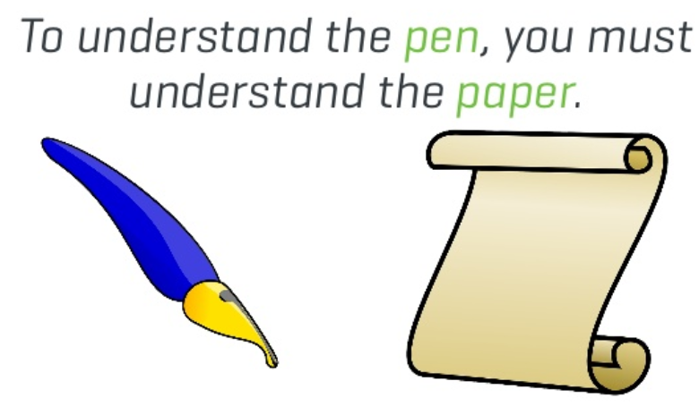
Continued….
Ethnographic research is conducted in context, typically over an extended period of time, and holistic, seeking the wider picture.

Slide 32
Feasibility Study
Feasibility is defined as the practical extent to which a project can be performed successfully.
To evaluate feasibility, a feasibility study is performed, which determines whether the solution considered to accomplish the requirements is practical and workable in the software.
Information such as resource availability, cost estimation for software development, benefits of the software to the organization after it is developed and cost to be incurred on its maintenance are considered during the feasibility study.
Some other objectives of feasibility study are:
- to analyze whether the software will meet organizational requirements
- to determine whether the software can be implemented using the current technology and within the specified budget and schedule
- to determine whether the software can be integrated with other existing software

Slide 33
Types of Feasibility Study
Technical Feasibility:
- assesses the current resources (such as hardware and software) and technology, which are required to accomplish user requirements in the software within the allocated time and budget
- software development team ascertains whether the current resources and technology can be upgraded or added in the software to accomplish specified user requirements
- Technical feasibility also performs the following tasks.
--- Analyzes the technical skills and capabilities of the software development team members.
--- Determines whether the relevant technology is stable and established.
--- Ascertains that the technology chosen for software development has a large number of users so that they can be consulted when problems arise or improvements are required.

Slide 34
Continued….
Operational Feasibility:
- assesses the extent to which the required software performs a series of steps to solve business problems and user requirements
- dependent on human resources (software development team) and involves visualizing whether the software will operate after it is developed and be operative once it is installed
- Operational feasibility also performs the following tasks.
--- Determines whether the problems anticipated in user requirements are of high priority.
--- Determines whether the solution suggested by the software development team is acceptable.
--- Analyzes whether users will adapt to a new software.
--- Determines whether the organization is satisfied by the alternative solutions proposed by the software development team.

Slide 35
Continued….
Economic Feasibility:
- determines whether the required software is capable of generating financial gains for an organization
- involves the cost incurred on the software development team, estimated cost of hardware and software, cost of performing feasibility study, and so on
- essential to consider expenses made on purchases (such as hardware purchase) and activities required to carry out software development
- Software is said to be economically feasible if it focuses on the issues listed below.
--- Cost incurred on software development to produce long-term gains for an organization.
--- Cost required to conduct full software investigation (such as requirements elicitation and requirements analysis).
--- Cost of hardware, software, development team, and training.

Slide 36
Continued….
Legal Feasibility:
- In Legal Feasibility study project is analyzed in legality point of view
- includes analyzing barriers of legal implementation of project, data protection acts or social media laws, project certificate, license, copyright etc
- can be said that Legal Feasibility Study is study to know if proposed project conform legal and ethical requirements.
Schedule Feasibility:
- In Schedule Feasibility Study mainly timelines/deadlines is analyzed for proposed project which includes how many times teams will take to complete final project which has a great impact on the organization as purpose of project may fail if it can’t be completed on time.

